Slide 1


Unintended Consequence for Emerging Technology:
Data Privacy
By. Breighel Buggs

Slide 2

Overview:
Unintended Consequence: DATA PRIVACY
- What is Data Privacy? (1 slide)
- What led to emerging technology having this consequence? (1 slide)
- In what ways do we utilize technology that could potentially lead to data privacy leaks and hacks? (3 slides)
- What are the solutions to prevent this consequence? (5 slides)
- How can we implement ACET and ISTE standards to help us take preventative measures? (1 slide)
-Resources (1 slide)

Slide 3
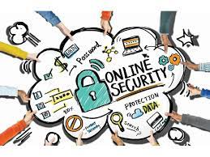
What is Data Privacy?
A citizen's right to decide how their personal information is gathered and utilized is known as data privacy. Privacy is a subset of data protection. This is since keeping user data private requires first securing sensitive information and user data. Federal officials oversee US data privacy legislation.

Slide 4
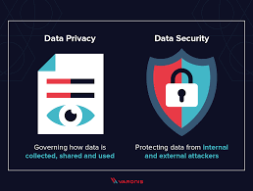
How did this become an issue in Tech?
Additional difficulties for privacy rights and laws are brought on by new technology. Many technology benefits come with a risk to your privacy.
Personally identifiable information, is one of the main issues with data privacy. The number and accuracy of data in our technologically advanced society make it difficult to manage millions, if not billions, of data records.

Slide 5
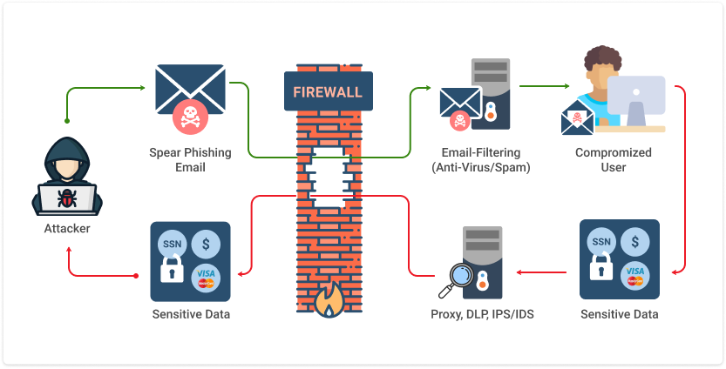
How technology use can led to data hacks and leaks of information?
When a user discloses their personal information by clicking on a phishing link.
Cybercriminals do not start data leaks. They become vulnerable due to unnoticed deficiencies and continue to be unwittingly public.

Slide 6
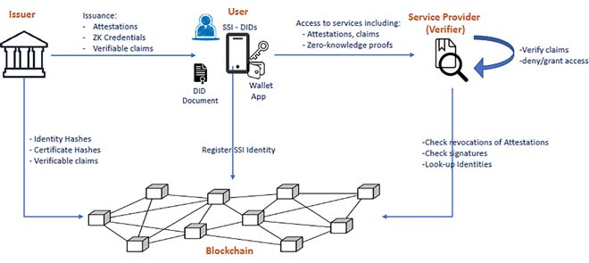

Slide 7
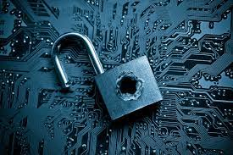

As a result, data privacy is now a problem that new developing technology makers must deal with.
Hacking and data leaks may lead to the demise of new technologies.

Slide 8
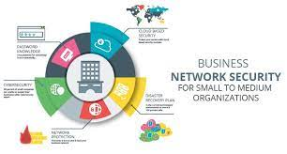
Solutions
Data protection is a key foundation
Create general data protection services for all startups in the technology sector.

Slide 9

Data leaks and hacks can be the downfall of emerging technology
Data Privacy
Solution:
Build Security into everything!

Slide 10
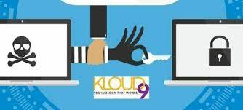

Data Privacy
Solution:
The most significant and successful privacy protection technology is undoubtedly encryption.
Everyone but the person who has the key needed to decrypt the data is unable to read anything that has been encrypted.

Slide 11
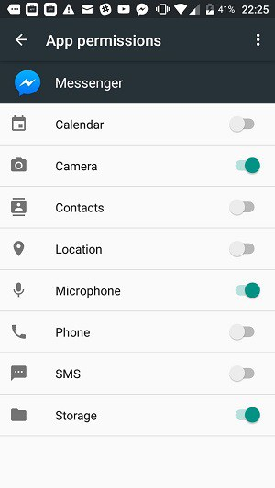

Data Privacy
Solution:
Ad blockers and regulating app access are two methods to lessen data privacy leaks.

Slide 12

Data Privacy
Solution:
One of the most popular methods to increase online privacy and minimize one's digital trace is to completely avoid social media.

Slide 13
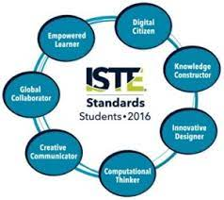

ACET
ISTE
They prepare everyone to be equipped in the proper use of technology as part of their approach to addressing these concerns.
A thorough road map for the efficient use of technology in classrooms around the world is provided by the ISTE Standards, which offer the competences for learning, teaching, and leading in the digital era.

Slide 14

This Presentation will be a great addition to all emerging technology start up companies that need to learn about how data privacy can be detrimental to not only the user, but the company and everyone involved as well.

Slide 15
Resources
Aguirre, E., Roggeveen, A. L., Grewal, D., & Wetzels, M. (2016). The personalization-privacy paradox: Implications for new media. Journal of consumer marketing.
Bernabe, J. B., Canovas, J. L., Hernandez-Ramos, J. L., Moreno, R. T., & Skarmeta, A. (2019). Privacy-preserving solutions for blockchain: Review and challenges. IEEE Access, 7, 164908-164940.
Bilal, A., Wingreen, S., & Sharma, R. (2020, March). Virtue ethics as a solution to the privacy paradox and trust in emerging technologies. In Proceedings of the 2020 the 3rd international conference on information science and system (pp. 224-228).
Jamil, G. L., & da Silva, A. R. (2021). Emerging technologies in a modern competitive scenario: Understanding the panorama for security and privacy requirements. Handbook of Research on Digital Transformation and Challenges to Data Security and Privacy, 1-16.
Shin, D. D. (2019). Blockchain: The emerging technology of digital trust. Telematics and informatics, 45, 101278.

