Slide 1

All Things English: ELL Multimedia Engagement
By: Breighel Buggs

Slide 2
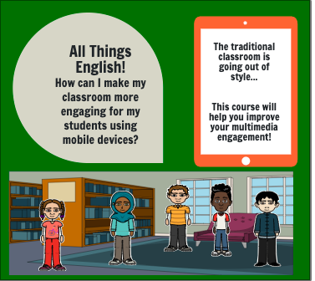
Create Mobile Device Apps specifically for English Language Learners
Discover online reading programs that you learn how to navigate for your students.
The educators will acquire the skills needed to assist students that are learning English as a Second Language. They will discover applications, navigate programs, and create multimedia engulfed lesson plans to enhance their digital literacy and teaching abilities.

Slide 3
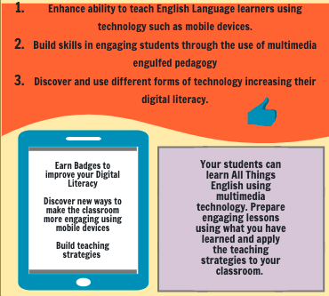

Slide 4
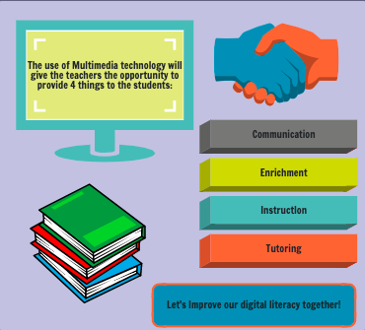
Build your students skills and abilities in academics, communication, and independent critical thinking

