Slide 1

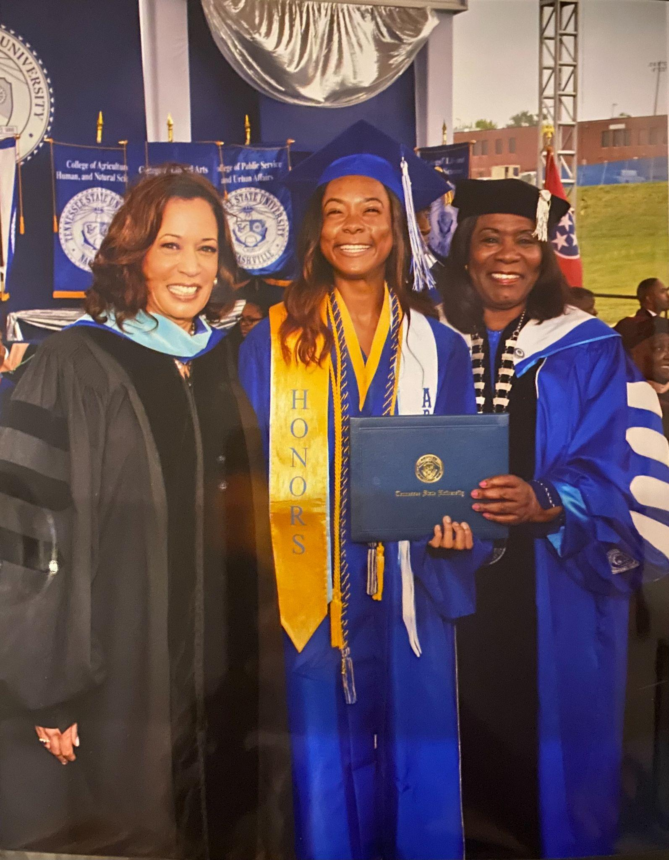


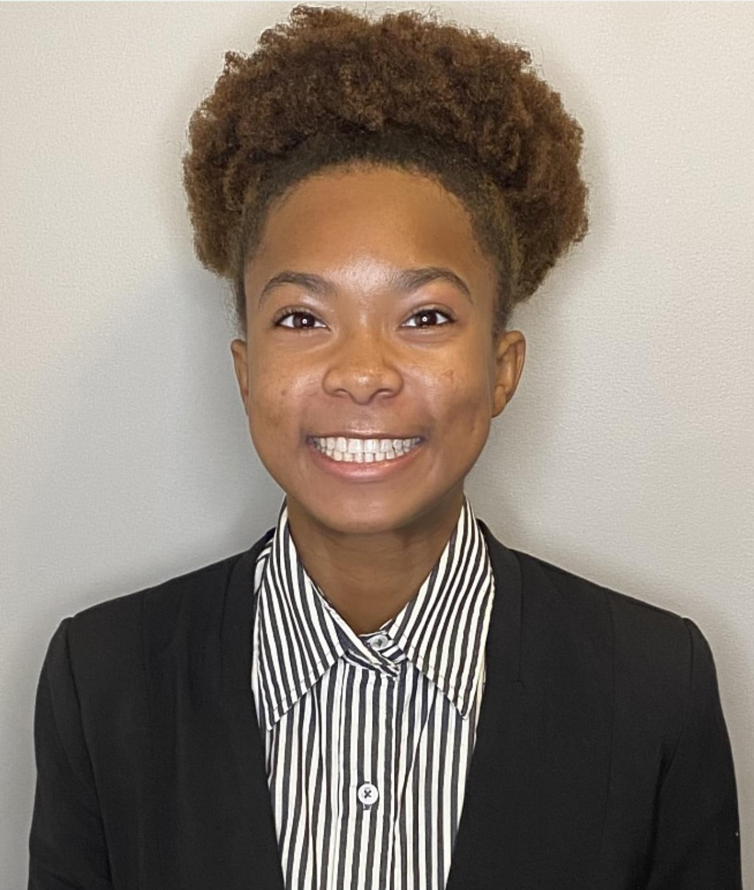












Inspirational Quote:
Every mountain top is in reach if you just keep climbing.
-Barry Finlay
Hello! Hola!
Hujambo!
مرحبًا!
Muraho!

Slide 2
Inspirational Quote:
Every mountain top is in reach if you just keep climbing.
“Students don’t care how much you know until they know how much you care.” -John C. Maxwell
-Barry Finlay
Hello! Hola!
Hujambo!
مرحبًا!
Muraho!
Fun Facts about me!
Fruit: Grapefruit
Color: Purple (Lavender shade)
Sports: Volleyball & Track
Animal: Koala
Season: Summer

Slide 3

About Ms. Buggs
Fun Facts about me!
Fruit: Grapefruit
Color: Purple (Lavender shade)
Sports: Volleyball & Track
Animal: Koala
Season: Summer
Inspirational Quote:
Every mountain top is in reach if you just keep climbing.
Email: Breighel.Buggs@mnps.org
Phone: 629-910-4782
Planning Time: 11:30-12:30
(Translation Services Provided In Advance Only)

Slide 4

Inspirational Quote: “Students don’t care how much you know until they know how much you care.” -John C. Maxwell
I care about you!
Let’s Learn Together!

Slide 5



Slide 6
Thanks for stopping by!
If you're determined to learn, no one can stop you!

