Slide 1
Click white Board
Welcome to
Ms. Buggs Classroom
Let’s get started!

Slide 2
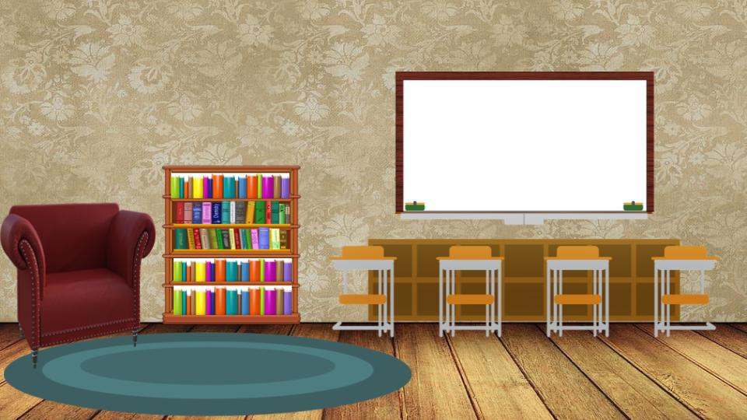






Good morning 3rd grade students!

Slide 3
History/Geography
To access the geography lesson for the day
Click on the Globe----->

Slide 4
Good morning 3rd grade students!

Slide 5


Great work so far!

Slide 6
Math
To access the math lesson for the day
Click the computer----->

Slide 7
Great work so far!

Slide 8


You really mastered fractions

Slide 9
Reading
and Language Arts
To access the reading assignment for the day
Click the textbook------>

Slide 10
You really mastered fractions

Slide 11


Keep going lovebug

Slide 12
Let’s see how well you know Time
To access the time activity
Click the Clock-------->

Slide 13
Keep going lovebug

Slide 14

That is all for today
class :)

Slide 15

Great job today!
See you tomorrow :)
By: Breighel Buggs

